Slide 1
Collecting the Data
Who will you collect data from

Slide 2
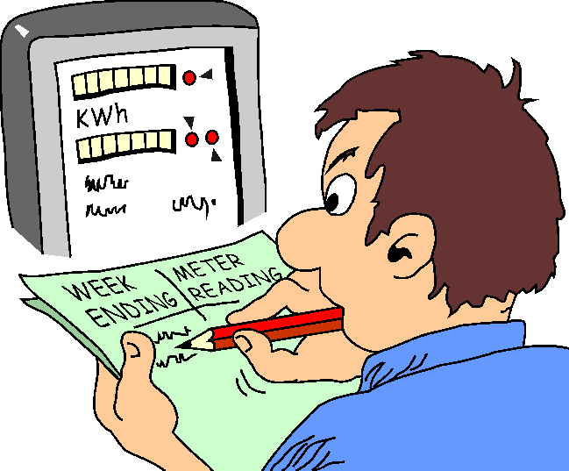
Collecting the Data
In this section we will be looking at getting our sample. What this entails and who, what or where we collect data from.

Slide 3
Collecting the Data
Five steps in the process of data collection.
What permissions will you need.
What information will you collect.

Slide 4
Collecting the Data
The difference between quantitative and qualitative extends through to not only the design of the study but right down to the what the subjects of the study are and how they are selected.

Slide 5
Collecting the Data
Five steps in the process of data collection.
The first step in the process of collecting data is to identify the people, places and the things you plan to study.

Slide 6
Collecting the Data
In the early stages of data collection you must decide on what level the data needs to be gathered. This level is called a unit of analysis. For example; individual, school or work place. In some cases researcher will gather data from multiple levels.

Slide 7

Collecting the Data
Population
A population are a group of individuals that share common characteristics, for example the students of Whitireia is the population, and the IT class is the sample of that population.

Slide 8
Collecting the Data
Specify the population and sample
The need to select individuals or organisations that are representative of the population. This is called a sample.

Slide 9
Collecting the Data
Probabilistic and Nonprobabilistic Sampling
Researchers employ either probability or non probability sampling methods. They decide which to use based on the type of study.

Slide 10

Collecting the Data
Probability Sampling
The researcher selects individuals from a population who are representative of that population. This is the most rigorous form of sampling because the researcher can claim that the sample is representative of the population.
This allows the researcher to make a generalization to the population

Slide 11
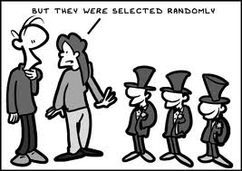
Collecting the Data
Types of Probability Sampling
Simple Random Sampling.
The researcher selects participants for the sample so that each individual has an equal probability of being selected from the population.

Slide 12
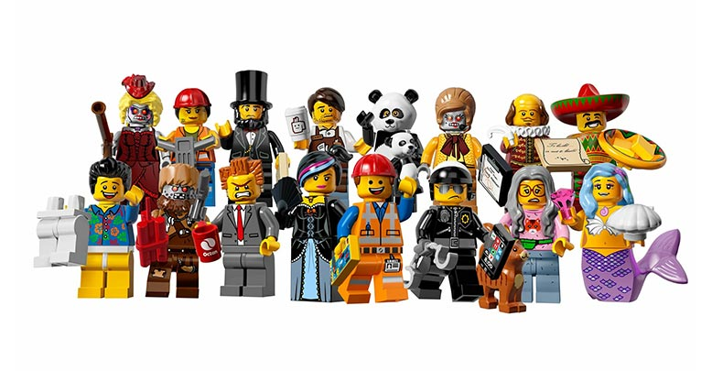
Collecting the Data
Random Sampling
Any bias in the population will be equally distributed among the sample chosen.

Slide 13
Collecting the Data
Random Sampling
Typical procedure used in random sampling is to assign a number to each individual in the population and then use a random number table or generator to select subjects.

Slide 14
Collecting the Data
Systematic Sampling
A slight variation on random sampling.
In this procedure you choose every nth individual in the population until you reach your desired sample size.

Slide 15
Collecting the Data
Systematic Sampling
This procedure is not as precise or as rigorous.
May be more convenient to use as you don’t have to assign numbers to every individual.

Slide 16
Collecting the Data
Stratified Sampling
The researcher divides(stratify) the population on some specific characteristic, i.e. gender.

Slide 17
Collecting the Data
Stratified Sampling
When do you use stratification – You use stratification when the population reflects an imbalance of a characteristic in a sample.

Slide 18
Collecting the Data
Stratified Sampling
Also is used when a random sample would provide too fewer participants in a specific category.

Slide 19
Collecting the Data
Multistage Cluster Sampling
The researcher chooses a sample in two or more stages because either researcher cannot easily identify the population or the population is too large.

Slide 20
Collecting the Data
Multistage Cluster Sampling
A researcher may randomly select groups and then select subjects from within those groups.

Slide 21
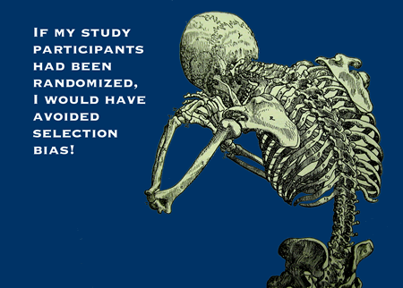
Collecting the Data
Nonprobability Sampling
It is not always possible to randomly sample.
In nonprobability sampling the researcher selects subjects because they are available.

Slide 22
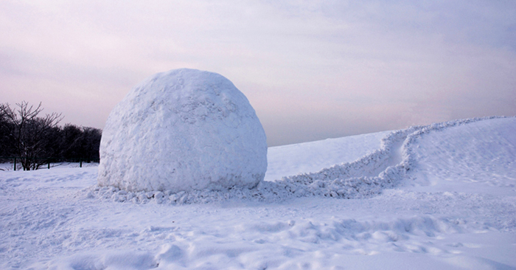
Collecting the Data
Nonprobability Sampling
The research selects individuals because they are available, convenient, and represent some characteristic the investigator wants to study. Researchers use two methods of nonprobability sampling, convenience and snowball.

Slide 23
Collecting the Data
Convenience sampling
Researcher selects participants because they are willing and available to be studied.
The researcher cannot with any confidence say that the individuals are representative of the population.

Slide 24
Collecting the Data
Snowball Sampling
The research asks participants to identify others to become subjects in the study.

Slide 25
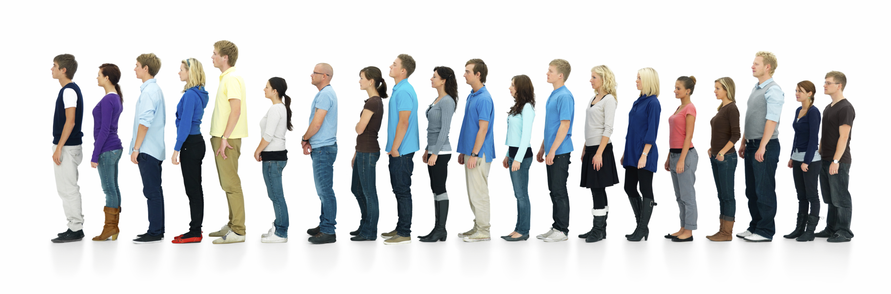
Collecting the Data
Sampling Size
When selecting participants for a study it is important to determine the size of the sample you need.

Slide 26
Collecting the Data
Sample Size
A general rule of thumb is to select as large a sample as possible. The larger the sample the less potential there is for sample being different from the population.
This difference between the sample and the population is called a sampling error.

Slide 27
Collecting the Data

